Slide 1
CS F372 Operating Systems
05 – CPU Scheduling-1
Chapter: 5
Sections: 5.1, 5.2, 5.3 (till 5.3.4)

Slide 2
Basic Concepts
Objective of multiprogramming is to have some program running always and hence maximize CPU utilization
Process execution consists of a cycle of CPU execution and I/O wait
CPU burst, I/O burst

Slide 3
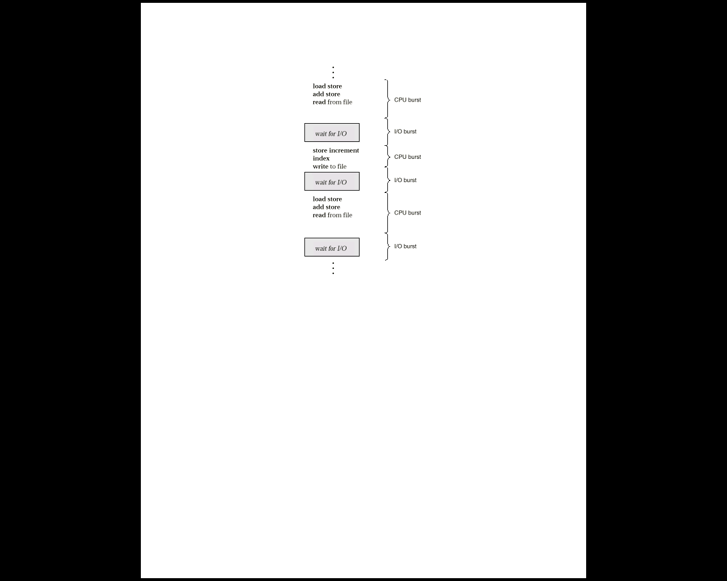
Alternating Sequence of CPU and I/O Bursts

Slide 4
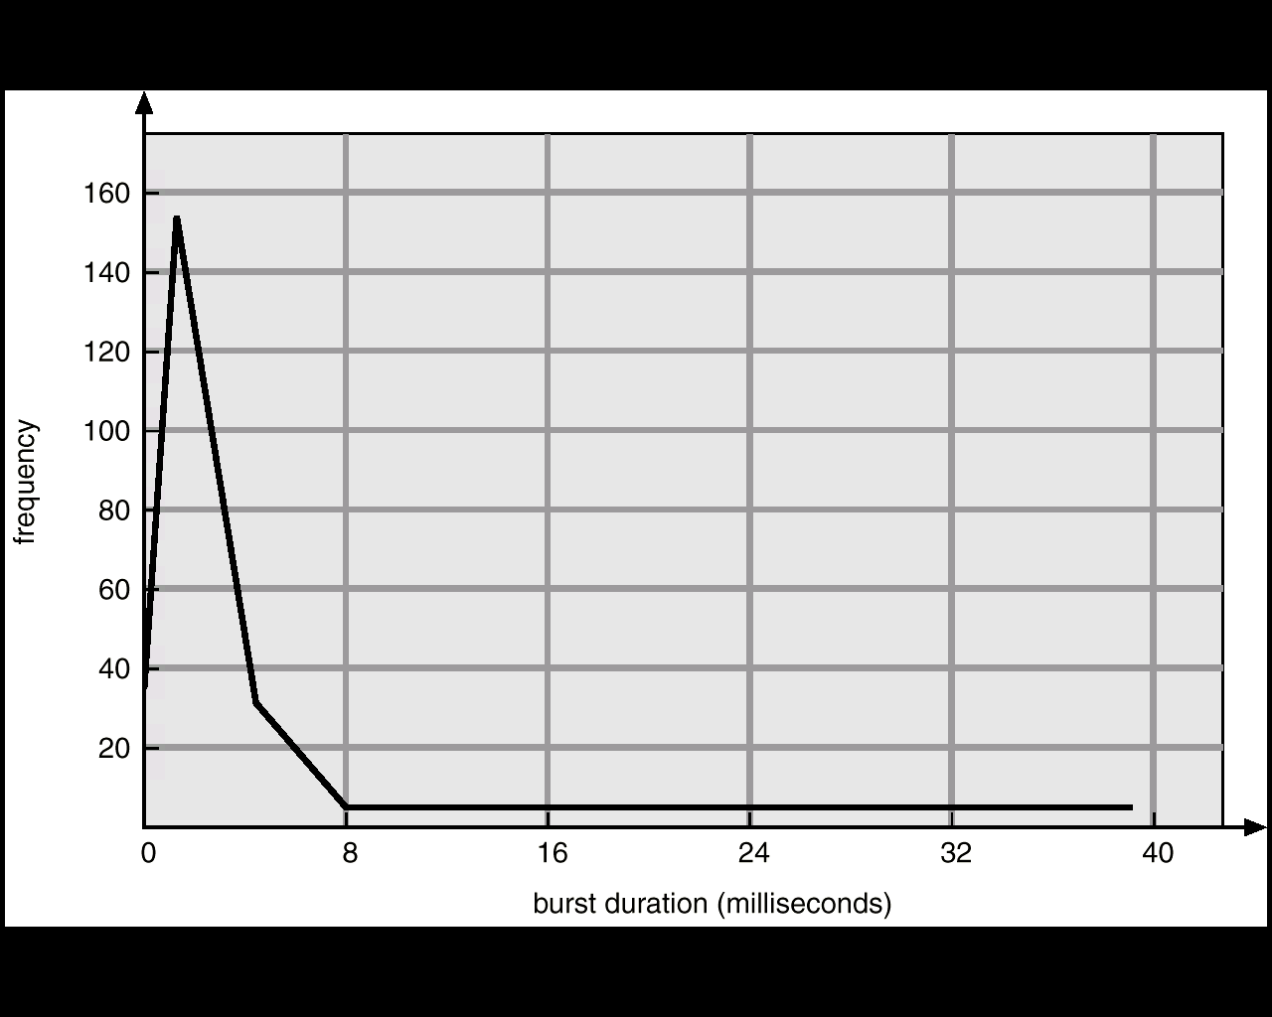
Histogram of CPU-Burst Times
A large number of short CPU bursts and a small number of long CPU bursts
CPU-bound program – very long CPU bursts
I/O-bound program – very short CPU bursts

Slide 5
CPU Scheduler
What is a CPU scheduler?
Short term scheduler
Selects from among the processes in memory that are ready to execute
Processes are selected from the ready queue
Ready queue may be a FIFO queue, a priority queue, a tree etc.

Slide 6
Dispatcher
Dispatcher module gives control of the CPU to the process selected by the short-term scheduler; this involves:
switching context
switching to user mode
jumping to the proper location in the user program to restart that program
Dispatch latency – time taken for the dispatcher to stop one process and start another process.

Slide 7
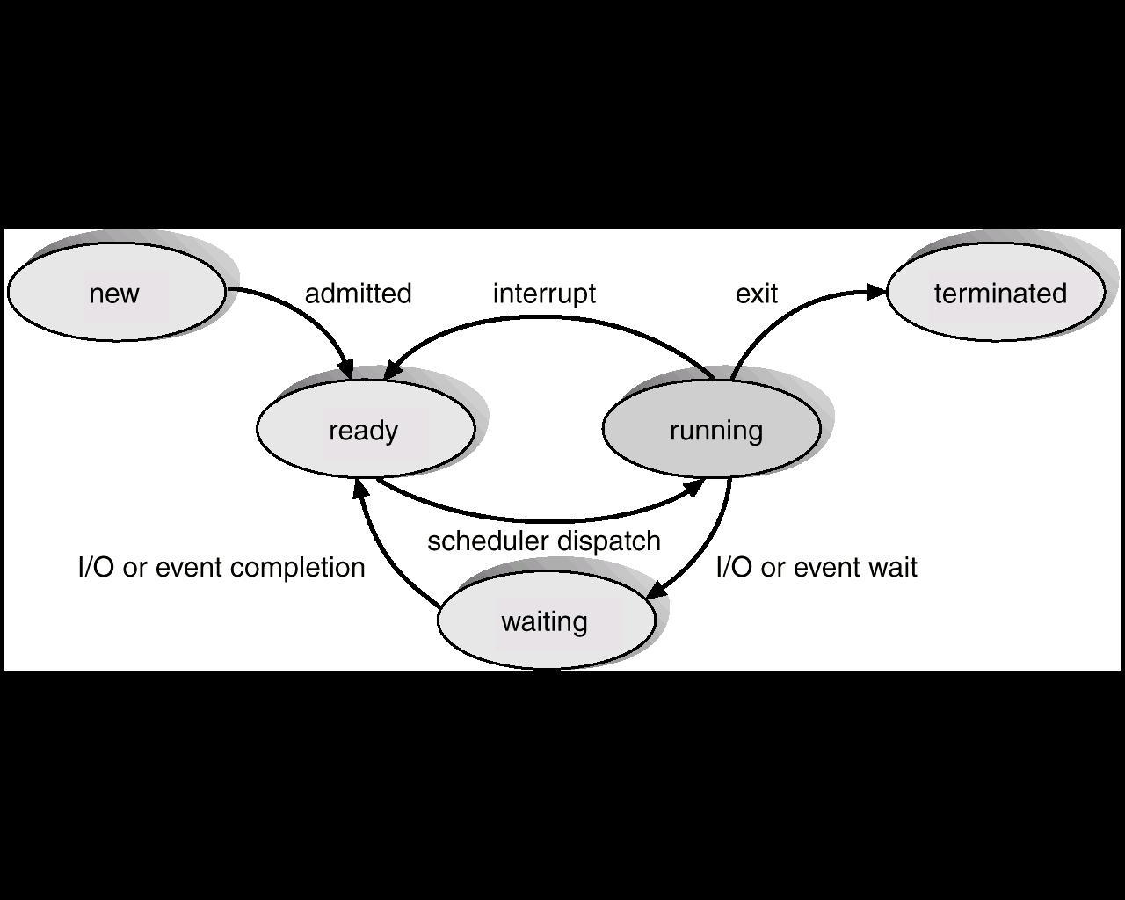
CPU Scheduling decisions
CPU scheduling decision takes place when a process:
Switches from running to waiting state (I/O, wait call)
Switches from running to ready state (interrupt)
Switches from waiting to ready (completion of I/O)
Terminates.

Slide 8
Nonpreemptive vs. preemptive
Nonpreemptive or cooperative: once the CPU has been allocated to a process, the process keeps the CPU until it releases the CPU either by terminating or by switching to the waiting state
Eg. Microsoft Windows 3.x.
Preemptive: the CPU is forcibly taken away from the process by the OS
Eg. Windows 95 and subsequent versions of Windows OS

Slide 9
Preemptive scheduling
Preemptive scheduling can result in race conditions when data are shared among several processes
Preemption also affects the design of the operating-system kernel

Slide 10
Scheduling Criteria
CPU utilization – Keep the CPU as busy as possible
Throughput – No. of processes that complete their execution per time unit
Turnaround time – amount of time to execute a particular process. The interval from the time of submission of a process to the time of completion
Waiting time – amount of time a process has been waiting in the ready queue
Response time – amount of time it takes from when a request was submitted until the first response is produced, not output (for time-sharing environment)

Slide 11
Optimization Criteria
Max CPU utilization
Max throughput
Min turnaround time
Min waiting time
Min response time

Slide 12
First-Come, First-Served (FCFS) Scheduling
When the CPU is free, it is allocated to the process at the head of the queue
On the negative side, the average waiting time under the FCFS policy is often quite long
FCFS is non-preemptive
Simplest CPU-scheduling algorithm
The process that requests the CPU first is allocated the CPU first
Implementation FIFO queue
When a process enters the ready queue, its PCB is linked onto the tail of the queue.

Slide 13
First-Come, First-Served (FCFS) Scheduling
Draw the Gantt chart that illustrate the execution of these processes using FCFS scheduling algorithm
What is the waiting time of each process?
What is the average waiting time?
What is the turnaround time of each process?
What is the average turnaround time?
Consider the following set of processes that arrive at time 0, in the order: P₁, P₂, P₃ with the length of the CPU burst given in milliseconds
Process Burst Time
P₁ 24
P₂ 3
P₃ 3

Slide 14
First-Come, First-Served (FCFS) Scheduling
Gantt chart: It is a bar chart that illustrates a particular schedule, including the start and finish times of each of the participating processes
Process Burst Time
P₁ 24
P₂ 3
P₃ 3
P₁
P₂
P₃
0
24
30
27

Slide 15
First-Come, First-Served (FCFS) Scheduling
P₁
P₂
P₃
0
24
27
30
Waiting time for P₁ = 0; P₂ = 24; P₃ = 27
Average waiting time: (0 + 24 + 27)/3 = 17
Turn around time for P₁ = 24; P₂ = 27; P₃ = 30
Average turn around time: (24+27+30)/3 = 27

Slide 16
First-Come, First-Served (FCFS) Scheduling
Suppose that the processes arrive in the order
P₂ , P₃ , P₁
Draw the Gantt chart that illustrate the execution of these processes using FCFS scheduling algorithm
What is the waiting time of each process?
What is the average waiting time?
What is the turnaround time of each process?
What is the average turnaround time?

Slide 17
First-Come, First-Served (FCFS) Scheduling
The Gantt chart is:
Waiting time for P₁ = 6; P₂ = 0; P₃ = 3
Average waiting time: (6 + 0 + 3)/3 = 3
Average turn around time: (3+6+30)/3 = 13
Much better than previous case.
P₂
P₃
P₁
0
3
6
30

Slide 18
First-Come, First-Served (FCFS) Scheduling
Convoy effect short process behind long process
Example: One CPU-bound (large) and a number of I/O bound processes lower CPU and device utilization

Slide 19
Shortest-Job-First (SJF) Scheduling
Associate with each process the length of its next CPU burst.
Use these lengths to schedule the process with the shortest time.
Two schemes
Nonpreemptive – once CPU is given to a process it cannot be preempted until it completes its CPU burst.
Preemptive – if a new process arrives with CPU burst length less than remaining time of current executing process, preempt. This scheme is known as the Shortest-Remaining-Time-First (SRTF)

Slide 20
Example: Non-Preemptive SJF
Consider the following set of processes that arrive at time given, with the length of the CPU burst given in milliseconds
Draw the Gantt chart that illustrate the execution of these processes using non-preemptive SJF scheduling algorithm
What is the waiting time of each process?
What is the average waiting time?
What is the turnaround time of each process?
What is the average turnaround time?
Process Arrival Time Burst Time
P₁ 0.0 7
P₂ 2.0 4
P₃ 4.0 1
P₄ 5.0 4

Slide 21
Example: Non-Preemptive SJF
Process Arrival Time Burst Time
P₁ 0.0 7
P₂ 2.0 4
P₃ 4.0 1
P₄ 5.0 4
Schedule (Gantt chart)
P₁
P₃
P₂
P₄
0
7
8
12
16

Slide 22
Example: Non-Preemptive SJF
P₁
P₃
P₂
P₄
0
7
8
12
16
Process Arrival Time Burst Time
P₁ 0.0 7
P₂ 2.0 4
P₃ 4.0 1
P₄ 5.0 4
Wait time P1 = 0, P2 = 6, P3 = 3, P4 = 7
Average waiting time = (0 + (8-2) + (7-4) + (12-5))/4 = 4
TAT P1 = 7, P2 = 10, P3 = 4, P4 = 11
Average turn around time = ((7-0) + (12-2) + (8-4) + (16-5))/4 = 32/4 =8

Slide 23
Example: Preemptive SJF
Consider the following set of processes that arrive at time given, with the length of the CPU burst given in milliseconds
Draw the Gantt chart that illustrate the execution of these processes using preemptive SJF (SRTF) scheduling algorithm
What is the waiting time of each process?
What is the average waiting time?
What is the turnaround time of each process?
What is the average turnaround time?
Process Arrival Time Burst Time
P₁ 0.0 7
P₂ 2.0 4
P₃ 4.0 1
P₄ 5.0 4

Slide 24
Example: Preemptive SJF
Process Arrival Time Burst Time
P₁ 0.0 7
P₂ 2.0 4
P₃ 4.0 1
P₄ 5.0 4
SJF (preemptive)
P₁
P₂
P₃
P₂
P₄
P₁
0
2
4
5
7
11
16

Slide 25
Example: Preemptive SJF
P₁
P₂
P₃
P₂
P₄
P₁
0
2
4
5
7
11
16
Process | Arrival time | Burst time | Waiting time | Turn around time
P1 | 0 | 7 | (11-2)=9 | 16
P2 | 2 | 4 | (5-4)=1 | (7-2)=5
P3 | 4 | 1 | (4-4)=0 | 1
P4 | 5 | 4 | (7-5)=2 | (11-5)=6
 |  |  | Avg: 12/4 = 3 | Avg: 28/4 = 7

Slide 26
Shortest-Job-First (SJF) Scheduling
SJF is optimal
Gives the minimum average waiting time
Difficulty in knowing the length of the next CPU burst

Slide 27
Determining Length of Next CPU Burst
Can only estimate the length
Can be done by using the length of previous CPU bursts, using exponential averaging
τ _{n+1} = α t _{n} + (1- α) τ _{n}

Slide 28
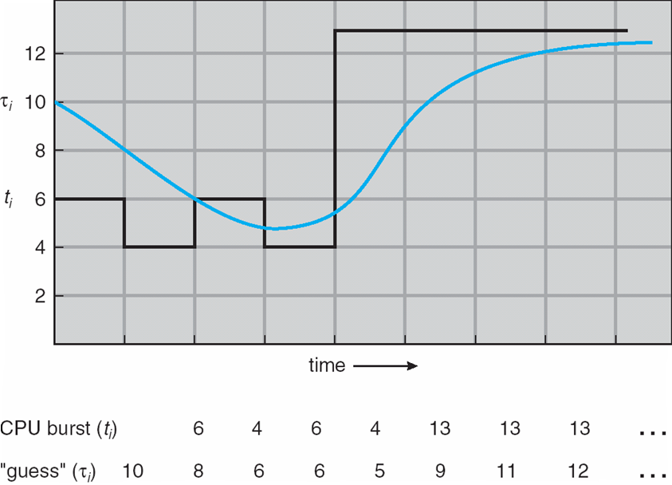
Prediction of the Length of the Next CPU Burst

Slide 29
Examples of Exponential Averaging
α =0
τ_{n+1} = τ_{n}
Recent history does not count.
α =1
τ_{n+1} = α t_{n}
Only the actual last CPU burst counts.

Slide 30
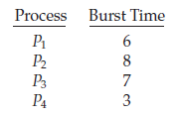
Home work 1
Draw the Gantt chart by considering the following set of processes, with the length of the CPU burst given in milliseconds if they were scheduled according to non preemptive SJF scheduling. Compute the average waiting time and average turn around time

Slide 31

In the case above the average wait time is ( 0 + 3 + 9 + 16 ) / 4 = 7.0 ms

Slide 32
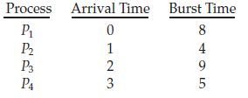
Home work 2
Draw the Gantt chart by considering the following set of processes, with the length of the CPU burst given in milliseconds if they were scheduled according to preemptive SJF scheduling. Compute the average waiting time and average turn around time

Slide 33

The average wait time in this case is ( ( 5 - 3 ) + ( 10 - 1 ) + ( 17 - 2 ) ) / 4 = 26 / 4 = 6.5 ms.

Slide 34
Priority Scheduling
A priority number (integer) is associated with each process
The CPU is allocated to the process with the highest priority (smallest integer ≡ highest priority).
Preemptive
Nonpreemptive
Equal priority processes are scheduled in FCFS order
SJF is a priority scheduling algorithm where priority is the inverse of the predicted next CPU burst time.
Priorities – defined internally or externally
Internal – number of open files, time limits, memory requirements etc.
External – Importance of the process, type and amount of funds being paid for computer use etc.

Slide 35
Priority Scheduling
Problem
Starvation – low priority processes may never execute
Solution
Aging – as time progresses increase the priority of the process

Slide 36
Example of Priority Scheduling (non-preemptive)
Process Burst Time Priority
P₁ 10 3
P₂ 1 1
P₃ 2 3
P₄ 1 4
P₅ 5 2
All process arrive at time 0

Slide 37
Example of Priority Scheduling (non-preemptive)
Process Burst Time Priority
P₁ 10 3
P₂ 1 1
P₃ 2 3
P₄ 1 4
P₅ 5 2
Priority (non-preemptive)
P2
P5
P1
P3
P4
0
1
6
16
18
19

Slide 38
Example of Priority Scheduling (non-preemptive)
P2
P5
P1
P3
P4
0
1
6
16
18
19
Process | Burst time | Priority | Waiting time | Turn around time
P1 | 10 | 3 | 6 | 16
P2 | 1 | 1 | 0 | 1
P3 | 2 | 3 | 16 | 18
P4 | 1 | 4 | 18 | 19
P5 | 5 | 2 | 1 | 6
AWT = 8.2, ATAT = 12

Slide 39
Preemptive priority scheduling
Consider the following set of processes that arrive at time given, with the length of the CPU burst given in milliseconds and priority.
Assume higher number represents higher priority
Draw the Gantt chart that illustrate the execution of these processes using preemptive priority scheduling algorithm
What is the waiting time of each process?
What is the average waiting time?
What is the turnaround time of each process?
What is the average turnaround time?
Process | Priority | AT | BT
P1 | 2 (L) | 0 | 4
P2 | 3 | 1 | 3
P3 | 4 | 2 | 1
P4 | 5 (H) | 3 | 5
P5 | 5 (H) | 4 | 2

Slide 40
Preemptive priority scheduling
P1 | P2 | P3 | P4 | P5 | P2 | P1
0 1 | 2 | 3 | 8 | 10 | 12 | 15
Process | Priority | AT | BT | TAT | WT
P1 | 2 (L) | 0 | 4 | 15 | 11
P2 | 3 | 1 | 3 | 11 | 8
P3 | 4 | 2 | 1 | 1 | 0
P4 | 5 (H) | 3 | 5 | 5 | 0
P5 | 5 (H) | 4 | 2 | 6 | 4
ATAT = 7.6; AWT = 4.6

Slide 41
Round Robin (RR)
Similar to FCFS but preemption is added to switch between processes. Used in time sharing environments
Each process gets a small unit of CPU time (time quantum), usually 10-100 milliseconds
After this time has elapsed, the process is preempted and added to the end of the ready queue
If the process has a CPU burst less than 1 time quantum, process will release the CPU voluntarily
If CPU burst is longer than 1 time quantum
Timer will go off
Interrupt to the operating system, Scheduler runs, Dispatcher runs
Context switch, process added to the tail of ready queue
Next process from the head of the ready queue selected by scheduler runs

Slide 42
Round Robin (RR)
If there are n processes in the ready queue and the time quantum is q, then each process gets 1/n of the CPU time in chunks of at most q time units at once
No process waits more than (n-1)q time units
Performance
q large ⇒ FCFS
q small ⇒ too many context switches
q must be large with respect to context switch time, otherwise overhead is too high.

Slide 43
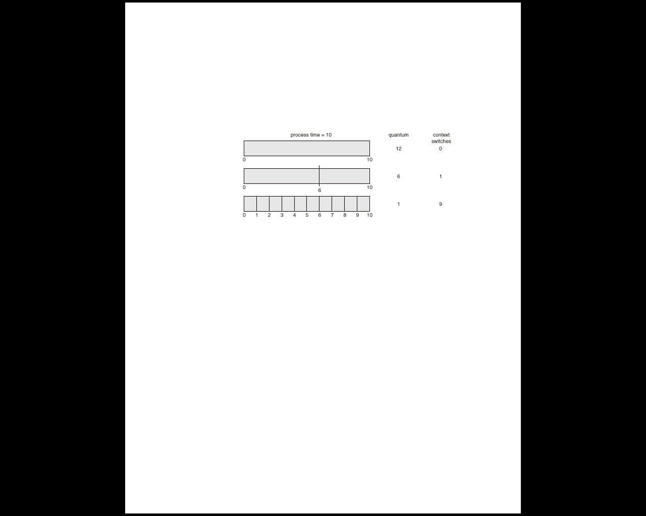
Time Quantum and Context Switch Time

Slide 44
Example of RR with Time Quantum = 20. All processes arrive at time 0 in the given order
Process Burst Time
P₁ 53
P₂ 17
P₃ 68
P₄ 24

Slide 45
Example of RR with Time Quantum = 20
Process Burst Time
P₁ 53
P₂ 17
P₃ 68
P₄ 24
The Gantt chart is:
Typically, higher average turnaround than SJF, but better response.
P₁
P₂
P₃
P₄
P₁
P₃
P₄
P₁
P₃
P₃
0
20
37
57
77
97
117
121
134
154
162

Slide 46
Example of RR with Time Quantum = 20
P₁
P₂
P₃
P₄
P₁
P₃
P₄
P₁
P₃
P₃
0
20
37
57
77
97
117
121
134
154
162
Process | Burst time | Waiting time | Turn around time
P1 | 53 | (77-20) + (121-97) = 81 | 134
P2 | 17 | 20 | 37
P3 | 68 | 94 | 162
P4 | 24 | 97 | 121
AWT = 73ms, ATAT = 113.5ms

